Slide 1

Project-4 - Bitcoin vs Tweets; Effect on Market Capitalization
Tony Garcia, Ismael Rodriguez, and Alex Li

Slide 2
Market capitalization (or market cap) is the total dollar value of all the shares of a company’s stock — or, in the case of Bitcoin or another cryptocurrency, of all the coins that have been mined. In crypto, market cap is calculated by multiplying the total number of coins that have been mined by the price of a single coin at any given time.
-
Coinbase.com

Slide 3

Project goals:
The goal of this project was to show if there was any correlation between activity on Twitter (total tweets/likes, and retweets having either hashtag of #BTC or #Bitcoin), and Bitcoin's market capitalization (market cap). For the machine learning (ML) portion of our project, we've used Linear Regression and the following three machine learning models to attempt to predict a future increase or decrease in Bitcoin's market cap. Market cap dataset contained prices beginning April 2013, and ending sometime in July of 2021

Slide 4
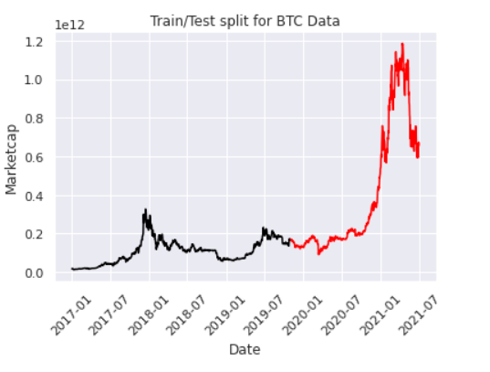
Train/Test split for BTC data:
Machine learning models were first trained on all market cap data before 2019 (we removed data before 2017 in the example above); data was then tested with market cap data at the end of 2019.

Slide 5
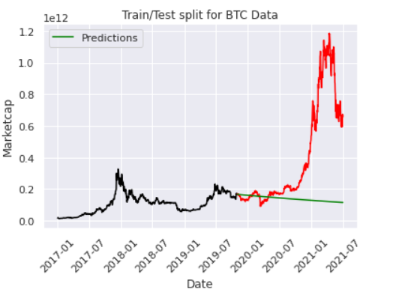
Graph of auto-regressing moving average (ARMA) model, with prediction:
Trained data is shown in black. Test data is highlighted in red, and prediction is shown in green.

Slide 6
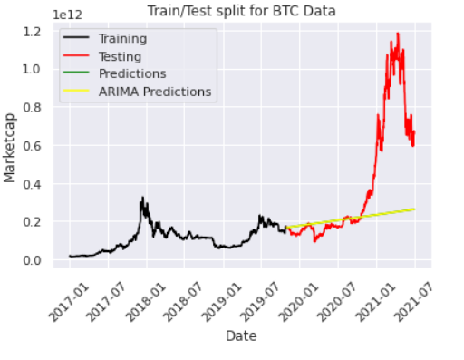
Graph of autoregressive integrated moving average (ARIMA) model's prediction:
ARIMA prediction is highlighted in yellow above.

Slide 7
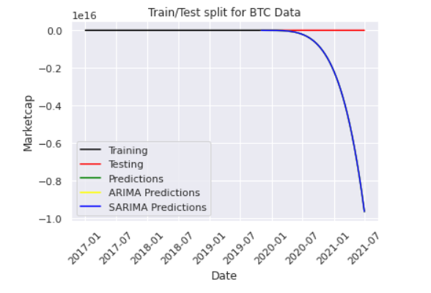
Graph of seasonal autoregressive integrated moving average (SARIMA) model's prediction:
Of the four ML methods used, SARIMA took the longest to run and appeared to predict a decrease in BTC price after 2021.

Slide 8

We found that results differed significantly when training the ML models to inspect market cap data from 2017 and beyond, dropping the front tail. With the training dates being less, and testing dates remaining the same, SARIMA then predicted that the price would decrease beyond 2021. With the entirety of data, beginning in 2013 however, SARIMA predicted an increase in BTC price.
Our Twitter dataset was limited, in that it only contained tweet information from the year 2021. Therefore, we were not able to find a correlation between tweets (overall BTC buzz on Twitter), and Bitcoin's market cap and/or price. A larger dataset, containing tweets from more than one year, may provide better results. The large size of our twitter dataset (1.5GB) made it difficult to work with. We were forced to use Pyspark to load and manipulate the dataset.

